Slide 1
Organizational Change and You
Increasing FUUN’s Likelihood of Success
Notes:
Organizations don’t just change because of new systems, processes or structures. They change because the people within the organizations adapt and change too. Only when the people within it have made their own personal transitions can an organization truly reap the benefits of change.

Slide 2
Why We’re Here
Like it or not—change is coming
Strategic Plan
Identity Task Force
Transit Team
Leaders like you are the ones others look to
Notes:
Strategic plan presented in 2016. Called for an Identity Task Force to define what we want to be.
Transit Team defined ministerial needs and helped smooth way when Jason Shelton, associate minister for music, left. Will revive to develop plans to implement Identity Task Force findings.
“Change or die.” Why do organizations have to change?

Slide 3
What We’ll Be Talking About
Potential changes at FUUN
The typical phases of change in organizations
Strategies for dealing with each phase
Human dynamics during change (SHIFT)
Strategies for managing SHIFT
Notes:
This is first of a two-part look at change management

Slide 4
Change? What Change?
Size
Location
Governance
Budget
Committees
Senior Minister
Beloved Community
Sanctuary Efforts
Notes:
Can’t remain same size: too big to be managed by volunteers, budget too small to hire adequate staff
Whatever size we ultimately decide to become, there are location issues. If we move, where to? If we stay, how do we improve the current campus?
Larger congregation requires different type of governance than we currently have
How do we afford whatever needs to be done?
What will committees look like in new identity? Fewer? To whom do they report?
Sr. minister is retiring in two years. New minister needs to be selected based on our vision of ourselves
What will initiatives by the Beloved Community look like?
If we become involved in sanctuary efforts, what changes are required?

Slide 5
The Challenge
Change can be traumatic. The Challenge is to help and support our people through their individual journey, thereby both helping people and accelerating the change.
Notes:
The easier we can make this journey for people the sooner our organization will benefit, and the more likely we are to be successful. However if we get this wrong, we could be heading for failure.

Slide 6
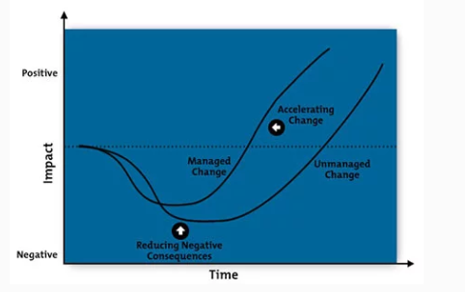
Benefits of Managing the Change
Notes:
As someone introducing change, you can use your knowledge of the Change Curve to give individuals the information and help they need, depending on where they are on the curve. This will help to accelerate change, and increase our likelihood of success.

Slide 7
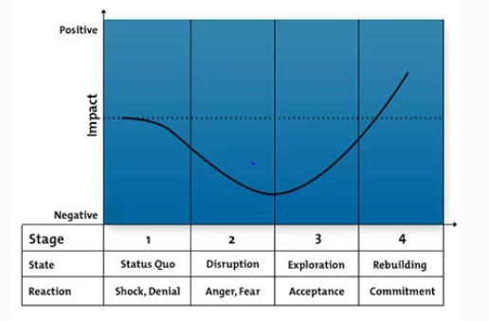
The Phases of Change
Notes:
The Change Curve is a popular and powerful model used to understand the stages of personal transition and organizational change. It helps to predict how people will react to change, so that you can help them make their own personal transitions, and make sure they have the help and support they need. There are 4 Stages of Change which include Status Quo, Disruption, Exploration and Rebuilding. People react differently through each of these stages. Note also that some people may move quickly through all stages, while others may take a lot longer to embrace the change.

Slide 8
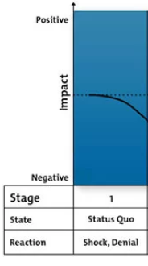
What To Do – Stage 1
Here people need information, need to understand what is happening. Make sure you communicate often, but also ensure that you don’t overwhelm people.
Notes:
Stage 1 - This is a critical stage for communication. People need information to know what is happening. People will only be able to take in a limited amount of information at a time. But make sure people know where to go for more information. Ensure you take the time to answer any questions that come up. Be prepared for some people to react with shock or denial.

Slide 9
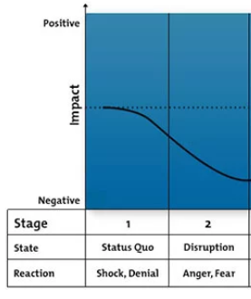
What To Do – Stage 2
Carefully consider the impacts and objections that people may have. Address these with clear communication and take action to minimize and mitigate problems.
.
Notes:
Stage 2 - For the organization, this stage is the “danger zone.” If this stage is badly managed, the organization may descend into crisis or chaos. They may feel the need to express their feelings and concerns, and vent their anger.
Make sure that you address these early with clear communication and support, and by taking action to minimize and mitigate the problems that people will experience. It is impossible to preempt everything, so make sure that you listen and watch carefully during this stage so you can respond to the unexpected.

Slide 10
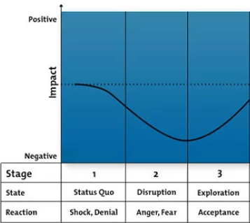
What To Do – Stage 3
Make sure people are well trained, and are given early opportunities to experience benefits of the change.
Notes:
Stage 3 - This is the turning point for individuals and for the organization. Individually they will need to test and explore what the change means. As the person managing the changes, you can lay good foundations for this stage by making sure that people are well trained and are given opportunities to experience the benefits of the change. Be aware this stage is vital for learning and acceptance. Build in contingency time so that people can learn and explore without too much pressure.

Slide 11
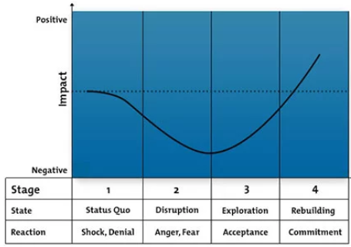
What To Do – Stage 4
Communicate our successes to help reinforce the change.
Notes:
Stage 4 - As someone managing the change, you’ll finally start to see the benefits you worked so hard for. Our organization starts to become more productive and efficient, and the positive effects start to appear.

Slide 12
In Summary
Organizational Change can be traumatic. The Change Curve helps to predict how people will react to change. Use it to help people with their individual journeys. Make sure they have the help and support they need.
Notes:
While you are busy counting the benefits, don’t forget to celebrate success!!! They journey may have been rocky. Certainly, it will have been at least a little uncomfortable for some people involved. But everyone deserves to share the success. What’s more by celebrating the achievement, you establish a track record of success, which makes things easier next time change is needed.

Slide 13
Why People Resist Change
Poor plan or process
Lack of communication
Fuzzy/unclear details and goals
Failure to buy in to premise/principles
Fear of Loss
Security
Relationships
Resources
Power
Notes:
While a poor plan can scuttle any attempt at change, the greatest reason for resistance is fear of loss of something

Slide 14
Change Anxiety
Notes:
People can become anxious during times of change. And anxiety is contagious. Good leaders avoid taking on the anxiety of others and can stop its spread by recognizing the various behaviors that often accompany anxiety about change.

Slide 15
Anxiety
Anxiety
Anxiety
Anxiety
Anxiety
Anxiety
Anxiety
Notes:
Anxiety is contagious. If it not addressed, pockets of anxiety will spring up in a number of places.

Slide 16
Taming Anxiety
Notes:
Understanding the sources and forces of anxiety in an organization are key to taming it. To do that, let’s look at the SHIFT model

Slide 17
SHIFT Model
Self-differentiation
Homeostasis
Identified Patient or Anxiety
Family Field
Triangulation
Notes:
SHIFT model described by Edwin Friedman and comes out of family therapy; but it tends to hold true for organizations as well.

Slide 18
Self-Differentiation
One’s ability to balance separateness and togetherness in a relationship
Sense of self alone
Sense of self as part of a relationship
Emotional objectivity in emotional situations while still relating to the other players
Notes:
Healthy life requires balance. Anxiety (for example during change) can upset that balance
Out of balance: emotional fusion when there is an overemphasis on harmony, acceptance and belonging; emotional cutoff when there is greater identity over or against others in order to gain positives for oneself.

Slide 19
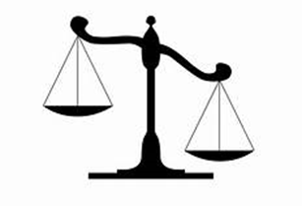
Self-Differentiated
Self Group
Fusion
Undifferentiated
Self Group
Cut-off
Self Group
Notes:
Think of a balance. The self-differentiated person balances being oneself with being in relationship with the group. The undifferentiated person may take one of two directions: fusion, in which identity with the group is so strong it overrides personal beliefs and well-being. This person will do just about anything he or she sees as keeping the group together. As a result, will appear changeable with public opinion.
In cut-off, the individual has such strong self identity or needs that he/she ignores the group needs and may actually sabotage group efforts to achieve his own ends. There are two courses of action for the person in cut-off mode—actually walking away from the group or remaining and manipulatnig it to his/her own goals.

Slide 20
Comparison
Undifferentiated
Self-Differentiated
Thoughtful, deliberate
Focuses on self; sees own impact and modifies behavior
Stays connected to others, works toward pre-set goals
reactive
focuses outside self and how others are reacting
Either connects emotionally or disconnects completely
Notes:
What might sustaining principles or values be? Mission, 7 principles, vision, covenant
Focus on self is not selfish—it means being thoughtful about one’s actions/reactions
Example: When an organization begins to change, and anxiety appears, self-differentiated will stay focused on what we’re trying to accomplish (highest principle): enable our congregation to thrive in whatever form we have determined is best. May change goals if they see something isn’t working as planned, but not because anxiety of others is getting to them. Works with everyone to hear, understand and keep them focused on the end.
When change is happening, the undifferentiated will either check out (cut-off) or become anxious and seek to change the plan to appease others

Slide 21
Comparison
Undifferentiated
Self-Differentiated
Sets clear goals and stays on course
Seeks challenge, understanding that this will create new things
Sets vague goals, changes with mood or events
Seeks security or power over
Notes:
SD may re-evaluate goals, but not based on whether people like him/her
Example: When an organization begins to change, and anxiety appears, self-differentiated will stay focused on what we’re trying to accomplish (highest principle): enable our congregation to thrive in whatever form we have determined is best. May change goals if they see something isn’t working as planned, but not because anxiety of others is getting to them. Works with everyone to hear, understand and keep them focused on the end.
When change is happening, the undifferentiated will either check out (cut-off) or become anxious and seek to change the plan to appease others.

Slide 22
Self-Differentiated = Non-Anxious
Notes:
Self-differentiated leaders provide the non-anxious presence that allows organizations to fulfill their missions and covenants

Slide 23
How to Get There
Be present to yourself and reactions
Identify and recognize your landmines
Develop your sustaining principles
Look for highest principle involved in a situation
Self-differentiation is a process
Notes:
Have people pair or triple up and talk about their own landmines and when they have appeared

Slide 24
Homeostasis
Tendency of an organization to maintain the status quo
Works to undo ongoing change
Examples?
Notes:
New Year’s resolutions
Board resolves to stay out of committee operations
Congregation welcome to new people/ways

Slide 25
Overcoming Homeostasis
Recognize need for change
Identify why people resist change
More in Part II

Slide 26
Identified Patient
Individual who is focus of anxiety and blame…
…who takes on the anxiety of the system
Examples?
Notes:
The board—Go back to example in self-differentiated. The identified patient (board) would become anxious over people’s reaction to change. Some people might say the board is threatening their relationships with long-time friends and blame them. So the board would back off plans to split off another congregation, e.g.
Mothers in some families
Ministers or other staff in some congregations—Choir director blamed for poor sounding choir, threatened with termination. Found real problem was no child care so only members were aging.

Slide 27
“Curing” the IP
Self-differentiation
Help group identify the real problems
Call out blaming behavior
Remember your covenant

Slide 28
Family Field
Baggage brought from somewhere else
Biological family
Organizational family
Examples?
Notes:
Birth order
Trauma survival
We tried it before and it didn’t work
We can’t have a strong central leader/they’ll take advantage of us

Slide 29
Overcoming History
Help group see what’s different
Help them move through
Notes:
What policies are/should be in place that make this different? How have things changed since then. How can you do things differently?

Slide 30
Triangulation
A has a problem with B
A goes to C with it
C agrees to talk to B about the problem
Examples?
Notes:
I don’t like the way a member of our committee seems to come late all the time. I go to the chair and ask her to talk to the person.
I don’t like what the new music director makes us wear on Sundays. I complain to her boss and ask that she talk to her about it.

Slide 31
Avoiding Triangulation
Recognize it
Refuse to participate
Notes:
Why it’s hard to avoid: C gets to be a “hero”

Slide 32
What’s Next?
Change Management, Part II (spring 2018)
DiSC personality styles (TBA)

Slide 33
Questions?

